Slide 1

TOEFL IBT
Wirda Ningsih

Slide 2

What is TOEFL iBT?

Slide 3
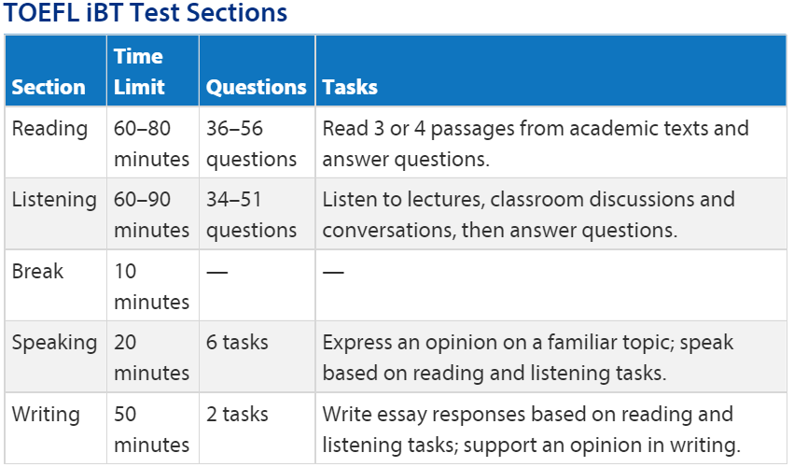

Slide 4
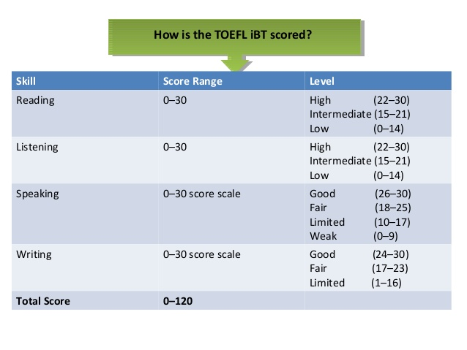

Slide 5
Why do we take this test?

Slide 6





Slide 7
What do we need to prepare?

Slide 8



Slide 9


Slide 10


